Slide 1
Advanced Modeling for Distribution Planning with OpenDSS
Instructor
Roger C. Dugan Sr. Technical Executive Sacramento, California June 22-23, 2017

Slide 2

Instructor
Roger C. Dugan, Life Fellow, IEEE
Roger is a Sr. Technical Executive with EPRI in Knoxville, Tennessee USA. He has over 45 years of combined experience in distribution engineering with EPRI, Electrotek Concepts, and Cooper Power Systems. He holds the BSEE degree from Ohio University and the Master of Engineering in Electric Power Engineering degree from Rensselaer Polytechnic Institute, Troy, NY. Roger has worked on many diverse aspects of power engineering over his career because of his interests in applying computer methods to power system simulation. Beginning with a student internship with Columbus and Southern Ohio Electric Co, his work has been focused on Distribution Engineering. He was elected a Fellow of the IEEE for his contributions in harmonics and transients analysis. Recently, he has been very active in distributed generation, particularly as it applies to utility distribution systems and distribution system analysis. He was the 2005 recipient of the IEEE Excellence in Distribution Engineering Award. He is coauthor of Electrical Power Systems Quality published by McGraw-Hill, now in its 3rd edition. He serves on the IEEE PES Distribution System Analysis Subcommittee and is active in the Distribution Test Feeders WG.

Slide 3
Introduction to the OpenDSS Program

Slide 4
What is the OpenDSS?
Many of the examples in this course will be taught using the EPRI OpenDSS computer program
The program is freely available and is updated regularly
You may find it on www.Sourceforge.net
Also, bookmark the EPRI link site:
http://smartgrid.epri.com/SimulationTool.aspx

Slide 5
What is the OpenDSS?
Script-driven, frequency-domain electrical circuit simulation tool
Specific models for:
Supporting utility distribution system analysis
Designed for the unbalanced, multi-phase North American power distribution systems
As well as European-style systems
These typically have a simpler structure

Slide 6
What is the OpenDSS? (cont’d)
Heritage
Harmonics solvers rather than power flow
Gives OpenDSS extraordinary distribution system modeling capability
Simpler to solve power flow problem with a harmonics solver than vice-versa
Supports all rms steady-state (i.e., frequency domain) analyses commonly performed for utility distribution system planning
And many new types of analyses
Original purpose: DG interconnection analysis

Slide 7
What is the OpenDSS? (cont’d)
What it Isn’t
An Electromagnetic transients solver (Time Domain)
It can solve Electromechanical transients
Frequency Domain => “Dynamics”
All solutions are in phasors (complex math)
Not a “Power Flow” program
Not a radial circuit solver
Does meshed networks just as easily
Not a distribution data management tool
It is a simulation engine designed to work with data extracted from one or more utility databases

Slide 8
What can OpenDSS be used for?
Simple power flow (unbalanced, n-phase)
Daily loading simulations
Yearly loading simulations
Duty cycle simulations
Impulse loads
Rock crushers
Car crushers
Renewable generation
DG
Interconnection studies/screening
Value of service studies (risk based)
Solar PV voltage rise/fluctuation
Wind power variations impact
Hi-penetration solar PV impacts
Harmonic distortion
Dynamics/islanding

Slide 9
What can OpenDSS be used for? (cont’d)
Hybrid simulation of communications and power networks
Geomagnetically-Induced Current (GIC) flow (solar storms)
Power delivery loss evaluations (EPRI Green circuits program - > 80 feeders)
Voltage optimization
PEV/PHEV impact simulations
Community energy storage (EPRI Smart Grid Demo)
High-frequency harmonic/interharmonic interference
Various unusual transformer configurations
Transformer frequency response analysis
Distribution automation control algorithm assessment
Impact of tankless electric water heaters
Wind farm collector simulations
Wind farm interaction with transmission
Wind generation impact on capacitor switching and regulator/LTC tapchanger operations
Protection system simulation
Open-conductor fault conditions
Circulating currents on transmission skywires
Ground voltage rise during faults on lines
Stray voltage simulations
Industrial load harmonics studies/filter design
Distribution feeder harmonics analysis, triplen harmonic filter design
And many more ….

Slide 10
Some Examples

Slide 11
Computing Annual Losses
Peak load losses are not necessarily indicative of annual losses

Slide 12
Using DSS to Determine Incremental Capacity of DG
“Needle” Peaking System
“How much more power can be served at the same risk of unserved energy?”
Broad Summer Peaking System

Slide 13
DG Dispatch

Slide 14
Solar PV Simulation

Slide 15
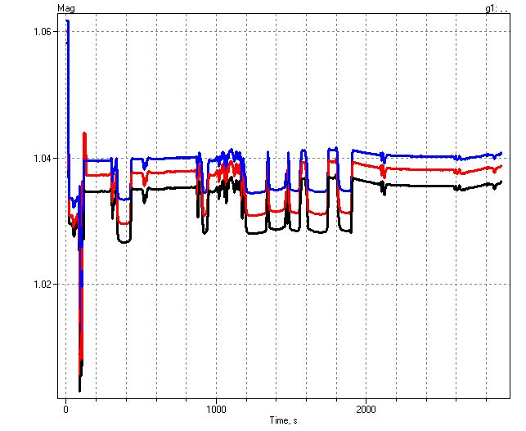
1-sec Solar Data – Cloud Transients
Impact on Feeder Voltage

Slide 16
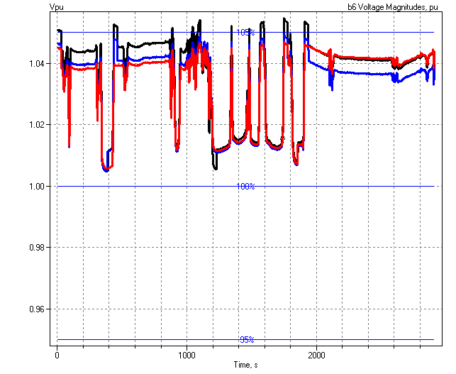
1-sec Solar PV Simulation Shows Voltage Regulation Issues
Regulator Operations

Slide 17
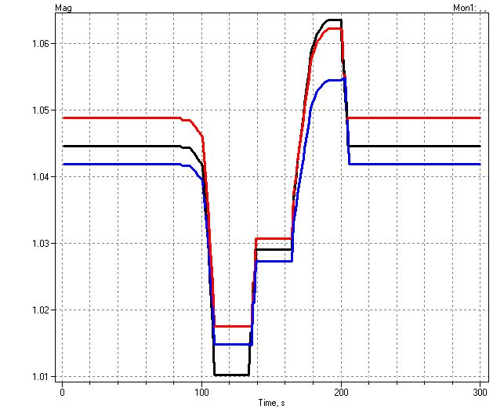
Example of an Expected DG Problem
Voltage overshoots as power output ramps up
Regulator taps up to compensate for voltage drop

Slide 18
Root of Problem
p.u. Voltage
Voltage Profile w/ DG
1.10
Distribution Systems designed for voltage DROP, not voltage RISE.
High Voltages
1.05
1.00
0.95
0.90
0.0
2.0
4.0
6.0
Distance from Substation (km)

Slide 19
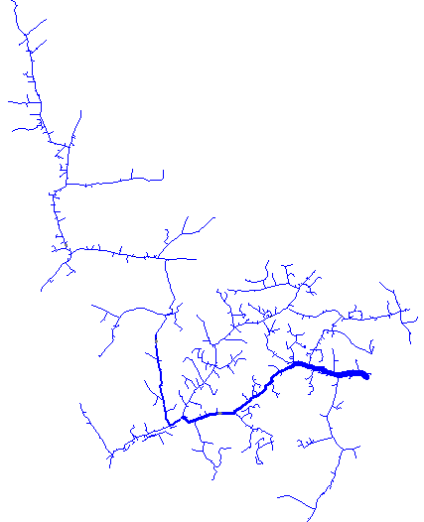
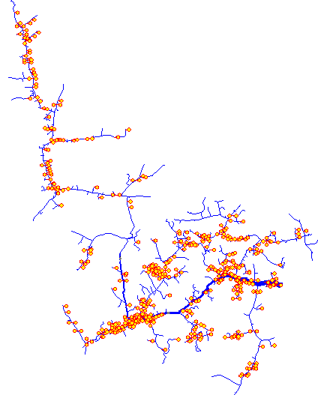
Use of Smart Inverters for Accommodating High-Penetration PV
Solar Rooftop PV
Solar Rooftop PV
With volt/var control
Volt-Var Control
Customer Load
Customer PV
Q1
Capacitive
System Voltage
Initial analysis indicated 25%-100% more PV can be accommodated using Volt/var control
VARs Generated
Q2
Q3
Inductive
V1
V2
V3
V4
Q4
20% PV
20% PV with volt/var control
Baseline – No PV
Source: J. Smith, T. Key “High-Penetration PV Impact Analysis on Distribution Systems,” Solar Power International, Oct 2011
24 Hour Simulation

Slide 20
Power Distribution Efficiency
Light Load Week
Peak Load (Capacity Planning)
Peak Load Week

Slide 21
Wind Plant 1-s Simulation
Notes:
The plot you see to the right is a sample case study we did where a developer wanted to install 3 750kW turbines at the end of a 10-mile distribution feeder. Along the feeder was a voltage regulator and large intermittent load. The concern we had was the impact the turbine output fluctuations would have on the flicker, regulator action, as well as the voltage profile along the feeder. Utilizing software that Electrotek had developed, specifically the Distribution System Simulator, or DSS,, minor modifications were made that allowed us to simulate the wind plant fluctuation impact over time, thus giving us the ability to address the concerns at hand.
The plot you see to the right is simulation output from the DSS, over a time horizon of ~ 4 minutes. The three turbines were modeled explicitly, along with the 5-step switched capacitor banks connected to each turbine as well as the voltage regulator upline from the wind plant. This software allows us to make recommendations to the utility and/or wind plant developer regarding modifications necessary, if any, to allow for the wind plant to have minimal impact on the distribution feeder and surrounding customers, or perhaps even improve feeder performance.
We also utilize this software for estimating flicker according the IEC standard 1400-21. The software, along with data specific to the turbine being considered allows one to estimate the flicker impact BEFORE the turbine is installed.

Slide 22
Broadband Driving Point Admittance
0.035
0.03
0.025
0.02
Siemens
|Y|
0.015
0.01
0.005
0
0
100000
200000
300000
400000
500000
Frequency, Hz

Slide 23
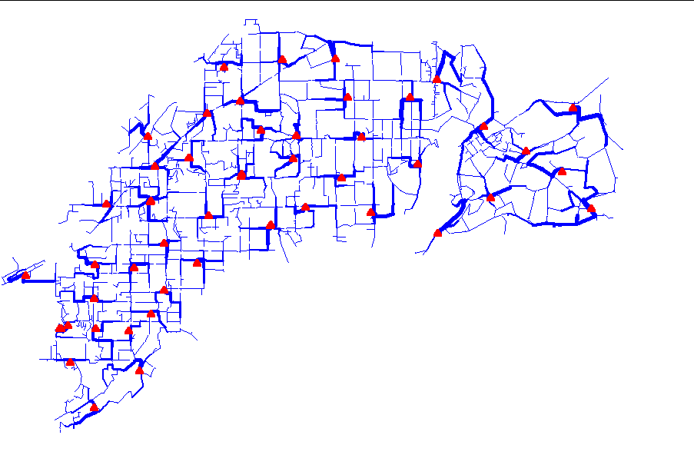
Power Flow Visualization

Slide 24
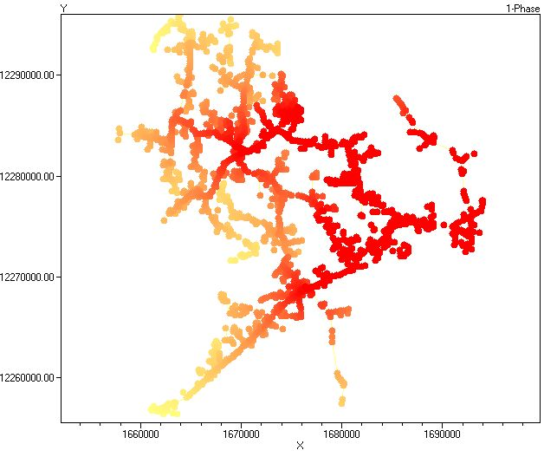
Special Displays
Fault Current Magnitudes

Slide 25
Time- and Location-Dependent Benefits
The OpenDSS was designed to capture both
Time-specific benefits and
Location-specific benefits
Needed for
DG analysis
Renewable generation
Energy efficiency analysis
PHEV and EV impacts
Other proposed capacity enhancements that don’t follow typical loadshapes

Slide 26
Time- and Location-Dependent Benefits
Traditional distribution system analysis programs
Designed to study peak loading conditions
Capture mostly location-specific benefits
Ignores time; Assumes resource is available
This gets the wrong answer for many DG, energy efficiency, and Smart Grid analyses
Must do time sequence analysis to get the right answer
“Quasi-Static Time-Series” (QSTS) simulations
Over distribution planning area

Slide 27
What are the Key Features?
Can model virtually any circuit configuration
Fast and efficient QSTS simulations
Designed to allow expansion indefinitely
Impossible to anticipate everything users will want to do
Scripting language and COM interface allows easier customization
OOP design of software makes it easy to add new circuit element models
See Documentation for more details
http://svn.code.sf.net/p/electricdss/code/trunk/Distrib/Doc/
Help menu on OpenDSS.exe

Slide 28
Built-in Solution Modes
Snapshot (static) Power Flow
Direct (non-iterative)
Daily mode (default: 24 1-hr increments)
Yearly mode (default 8760 1-hr increments)
Duty cycle (1 to 5s increments)
Dynamics (electromechanical transients)
Fault study
Monte carlo fault study
Harmonic
Custom user-defined solutions

Slide 29
Controls
A key feature is that controls are modeled separately from the devices being controlled
Capacitors
Regulators/tapchangers
Control Modes
Static
Power flows with large time steps
Time
Control queue employed to delay actions
Control acts when time is reached
Event

Slide 30
Overall Model Concept

Slide 31
User Interfaces Currently Implemented
A stand-alone executable program (OpenDSS.exe) that provides a text-based interface (multiple windows)
Some graphical output is also provided.
No graphical input is provided.
An in-process COM server (for Windows) that supports driving the simulator from user-written programs.
OpenDSSEngine.DLL
A direct DLL interface (OpenDSSDirect.dll) that mimics the COM interface with a standard call library
For non-Windows platforms, such as HPCs
For programming languages that do not support COM or are not efficient at supporting COM

Slide 32
Validation of OpenDSS
EPRI routinely checks OpenDSS power flow results against CYME, Synergi, and WindMil programs after converting data sets for various projects.
The OpenDSS program has been benchmarked against all the IEEE Test Feeders (OpenDSS versions installed with the program)
(http://ewh.ieee.org/soc/pes/dsacom/testfeeders/).
OpenDSS was used to develop the NEV test feeder and the 8500-node test feeder.
Used to develop the DG Protection test feeder and the YDY test case
For the EPRI Green Circuits project, computed load characteristics were calibrated against measured data for > 50 feeders.
Calibrated against measurements on feeders with 100% AMI

Slide 33
Needs Envisioned by EPRI for the Smart Grid (2007)
Sequential time simulation (QSTS)
Meshed network solution capability
Better modeling of Smart Grid controllers
Advanced load and generation modeling
High phase order modeling ( >3 phases)
Stray voltage (NEV), crowded ROWs, etc.
Integrated harmonics
NEV requires 1st and 3rd
User-defined (scriptable) behavior
Dynamics for DG evaluations
= Original Capabilities in 1997

Slide 34
Plan for Future Work/Enhancements
We are exploiting high performance desktop computing to make it feasible to study distribution systems of at least 100,000 nodes and perhaps as many as 1,000,000 nodes.
OpenDSS-PM (for Parallel Machine) developed in 2016 to perform parallel processing for faster QSTS simulations
Can solve different time periods in parallel
Employs Diakoptics to solve very large networks
Still under development with US DOE (Sandia & NREL) contract (since 2016)
Improved Distribution Management Systems (DMS) functions
Existing EPRI research project
Improved distribution state estimation functions
Improved microgrid simulations (Dynamics mode)

Slide 35
What’s Next?
Other Advanced Distribution System Analysis problems
Microgrids
Advanced inverters
Probabilistic planning
DMS and DA
Communications and control latency co-simulation
Masking of load growth by PV and other DG
Recloser siting
Training next generation distribution engineer for the “Integrated Grid”

